Slide 1

PowerShell Core – JumpStart to Building Cloud VM with Azure Resource Manager
Maximo Trinidad
Technology Evangelist
SAPIEN Technologies Inc.

Slide 2
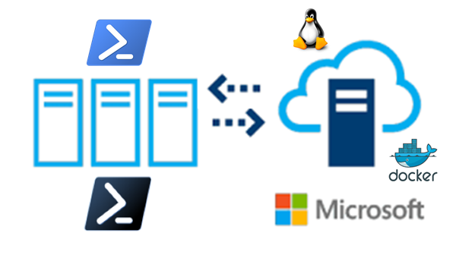




Cross-Platform Eco System
Lx

Slide 3

PowerShell Studio 2018
Script File Grouping
Custom Tools
Cache Editor
Object Browser
Script Debugging
Option – *New* Console setup
Extending use of Windows Console (*PSCore6)

Slide 4
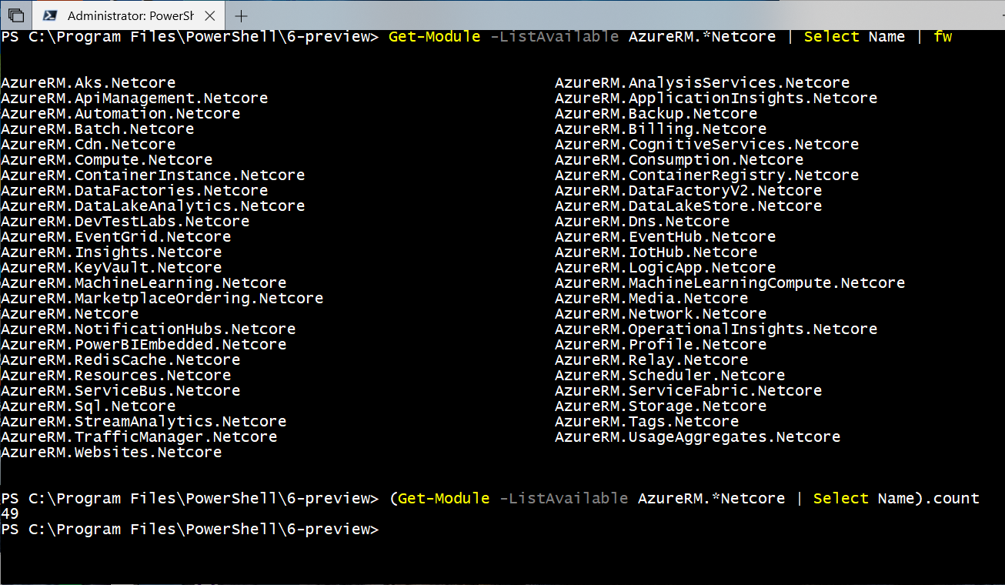
About AzureRM.NetCore for PowerShell Core
PowerShell Gallery AzureRM.Netcore module
Current version: 0.13.1 with 44 modules.
(Windows = 51 Modules)

Slide 5
Ways to Connect to Azure
Internet Browser – To get the Azure Portal.
Windows or Bash Console – For command scripting automation.
Cloud Shell – Provide both Windows and Bash for command scripting automation.

Slide 6
Login to AzureRM with PSCore6
Use Add-AzureRmAccount (one time)
No graphical prompt
Use the Browser
Use Save-AzureRmContext to save login in JSON file
Use Import-AzureRmContext to login

Slide 7
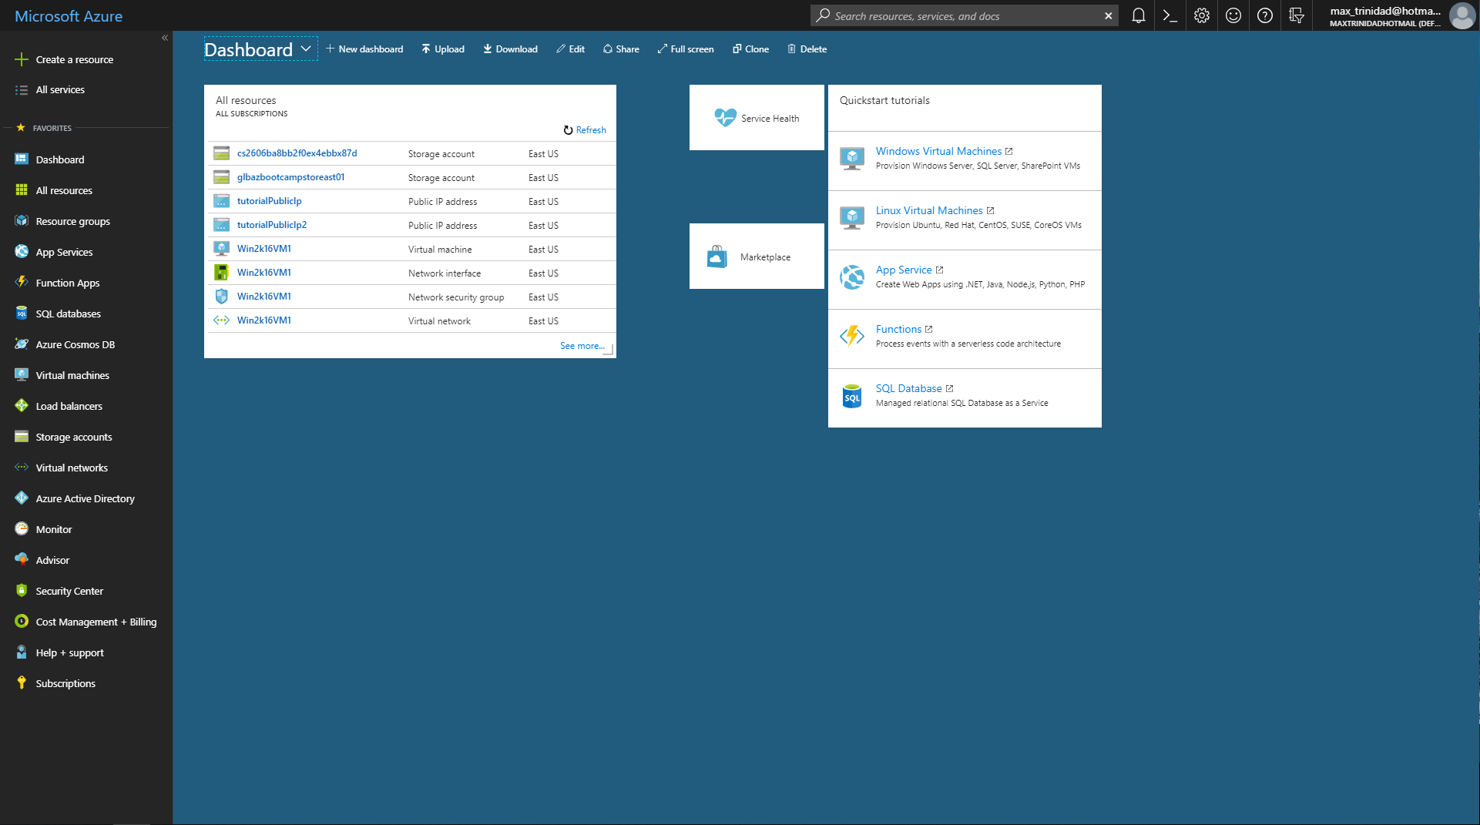
Azure Portal

Slide 8
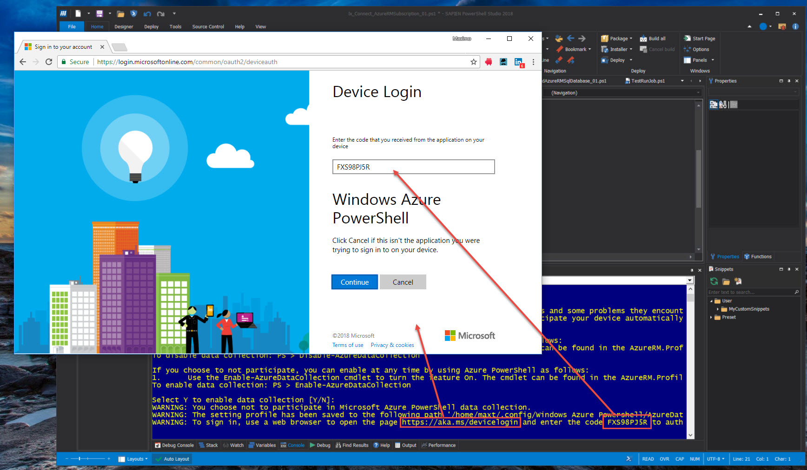
Console

Slide 9
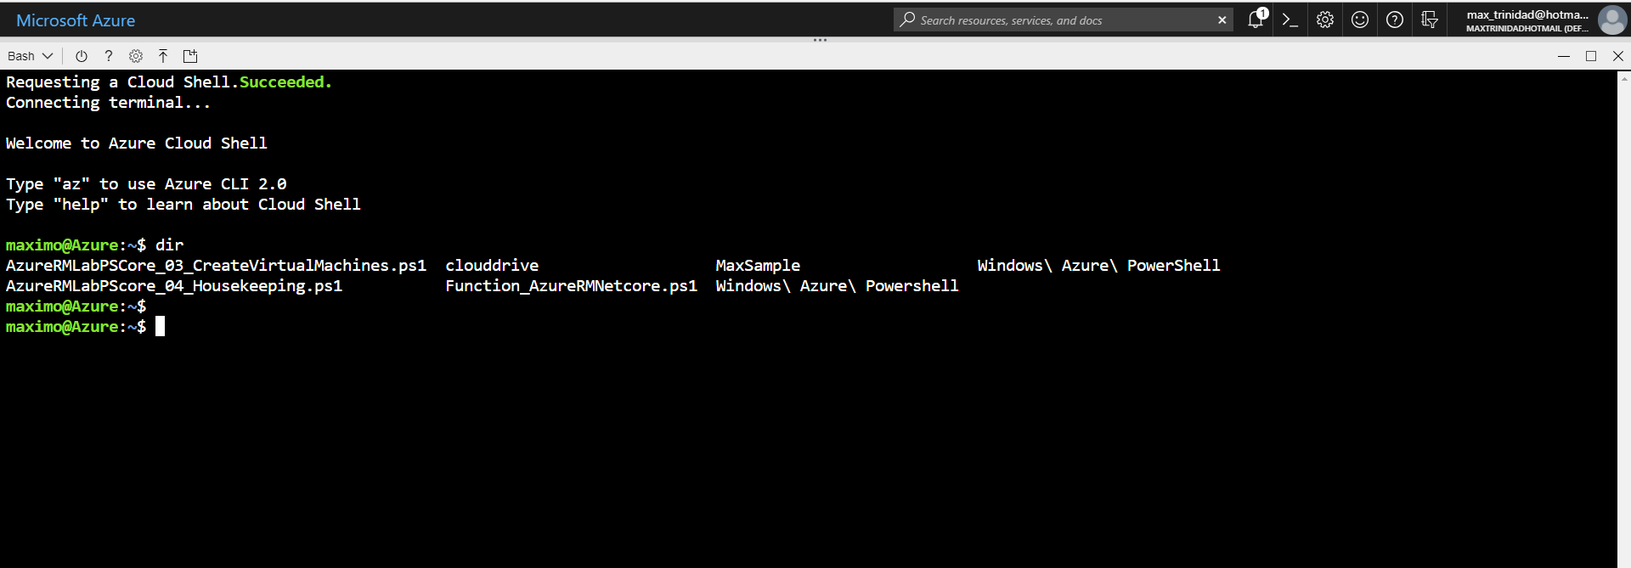
Cloud Shell

Slide 10
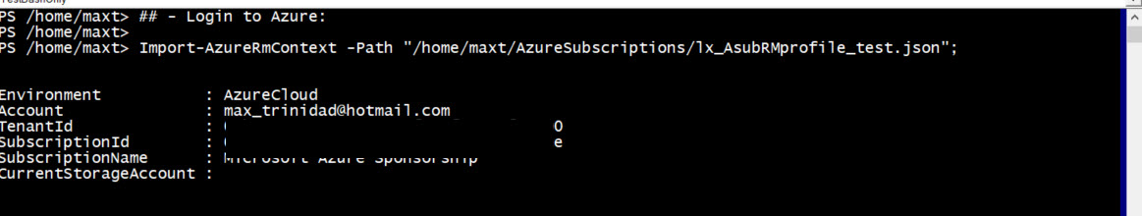
AzureRM One-liner *Login automation
*Note: The *JSON file create using AzureRM.Netcore is not in the same as the one built using in Windows AzureRM. => This is currently changing!

Slide 11
Linux – SSH key is needed
SSH Private key is needed before Configuring the VM
Set at the machine you’ll be using to remote connect to Linux VM
Use following command:
ssh-keygen -t rsa -b 4096 -C "max_trinidad@hotmail.com";
## - 'Accept default for saving the key file -> /home/user01/.ssh/id_rsa'

Slide 12
Demo
AzureRM Connection Scripting
Need a Azure Subscription
First time – use Add-AzureRMAccount
Core – Ask for Internet Browser
Create AzureRm VM
Windows
Azure Housekeeping
Managing VM’s
Check VM IPAddress
Cleanup Individual or All Resources.

Slide 13
Resources
Check out Jeffrey Snover video. In this video he mention that security has improve greatly and many other interesting thing about PowerShell: https://www.youtube.com/watch?v=myQkHM_je70#action=share
MonadManifesto: http://www.jsnover.com/Docs/MonadManifesto.pdf
PowerShell Core 6.0: Generally Available (GA) and Supported: https://blogs.msdn.microsoft.com/powershell/2018/01/10/powershell-core-6-0-generally-available-ga-and-supported/
PowerShell Core 6.1 Roadmap: https://blogs.msdn.microsoft.com/powershell/2018/01/24/powershell-core-6-1-roadmap/

Slide 14



Contact information:
Maximo Trinidad
Technology Evangelist
SAPIEN Technologies MVP 2017
IDERA ACE member 2017
Microsoft MVP - Cloud and Datacenter Management (since 2009)
Email: maxt@sapien.com, max_Trinidad@Hotmail.com
Blog: http://www.maxtblog.com/
Blog: http://www.sapien.com/
Twitter: @maxtrinidad
Twitter: @SapienTech

